Slide 1
Selenium OverView
- Jeet Kulkarni

Slide 2
Selenium OverView Agenda
History of Selenium
Selenium Architecture
Selenium Components
Locators
Practical example/snippet program using selenium.

Slide 3
History of Selenium
Primarily, Selenium was created by Jason Huggins in 2004, an engineer at ThoughtWorks. It was named as the "JavaScriptTestRunner.“
JavaScriptTestRunner was later made open-source and renamed as Selenium Core.
Another engineer at ThoughtWorks i.e. Paul Hammant gave birth to Selenium Remote Control(Selenium RC)
Selenium WebDriver - Simon Stewart
Selenium Grid – Patrick Lightbody
Selenium IDE – Shinya Kasatani

Slide 4
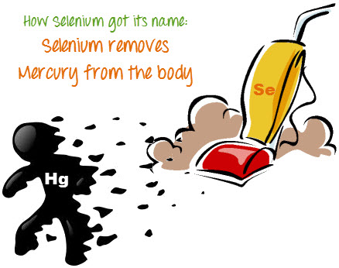
History of Selenium
Why the Name Selenium ?
Selenium is a Chemical mineral that cures the wounds caused by Mercury.

Slide 5
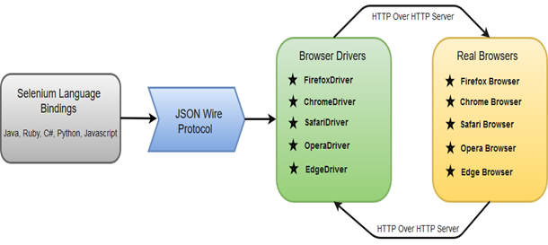
Selenium WebDriver - Architecture

Slide 6
Selenium Components
There are four basic components of WebDriver Architecture
Selenium Language Bindings - For instance, if you want to use the browser driver in java, use the java bindings.
JSON Wire Protocol
Browser Drivers
Real Browsers

Slide 7
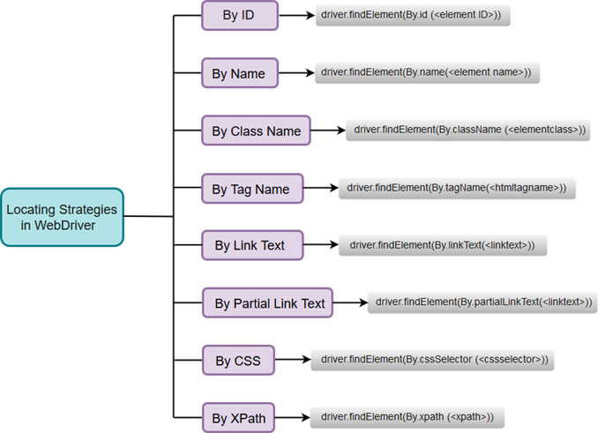
Selenium Locators

Slide 8
Practical example/snippet program using selenium

Slide 9
Questions ?

Slide 10
Thank You

